Slide 1
Orchestration with with Kubernetes
Srinivasan S Iyer

Slide 2

Intro - What is Kubernetes?
Kubernetes or K8s was a project spun out of Google as a open source next-gen container scheduler designed with the lessons learned from developing and managing Borg and Omega.
Kubernetes was designed from the ground-up as a loosely coupled collection of components centered around deploying, maintaining, and scaling applications.

Slide 3
Intro - What Does Kubernetes do?
Kubernetes is the linux kernel of distributed systems.
It abstracts away the underlying hardware of the nodes and provides a uniform interface for applications to be both deployed and consume the shared pool of resources.

Slide 4
Kubernetes Architecture Overview
Masters - Acts as the primary control plane for Kubernetes. Masters are responsible at a minimum for running the API Server, scheduler, and cluster controller. They commonly also manage storing cluster state, cloud-provider specific components and other cluster essential services.
Nodes - Are the ‘workers’ of a Kubernetes cluster. They run a minimal agent that manages the node itself, and are tasked with executing workloads as designated by the master.

Slide 5
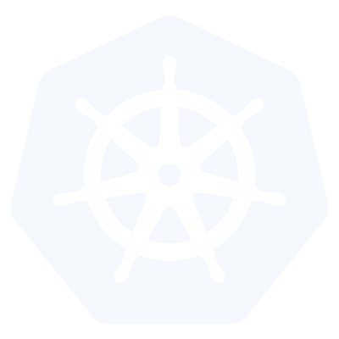
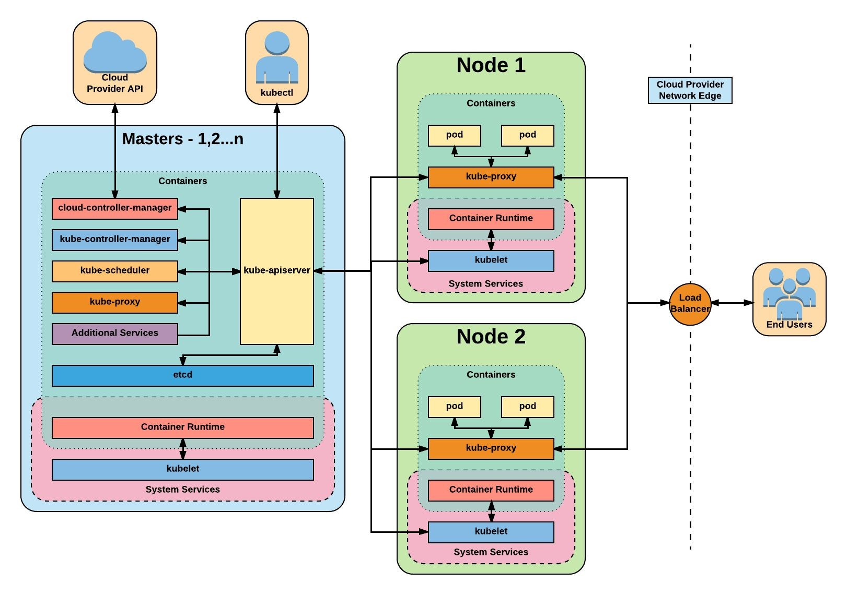
Architecture Overview

Slide 6
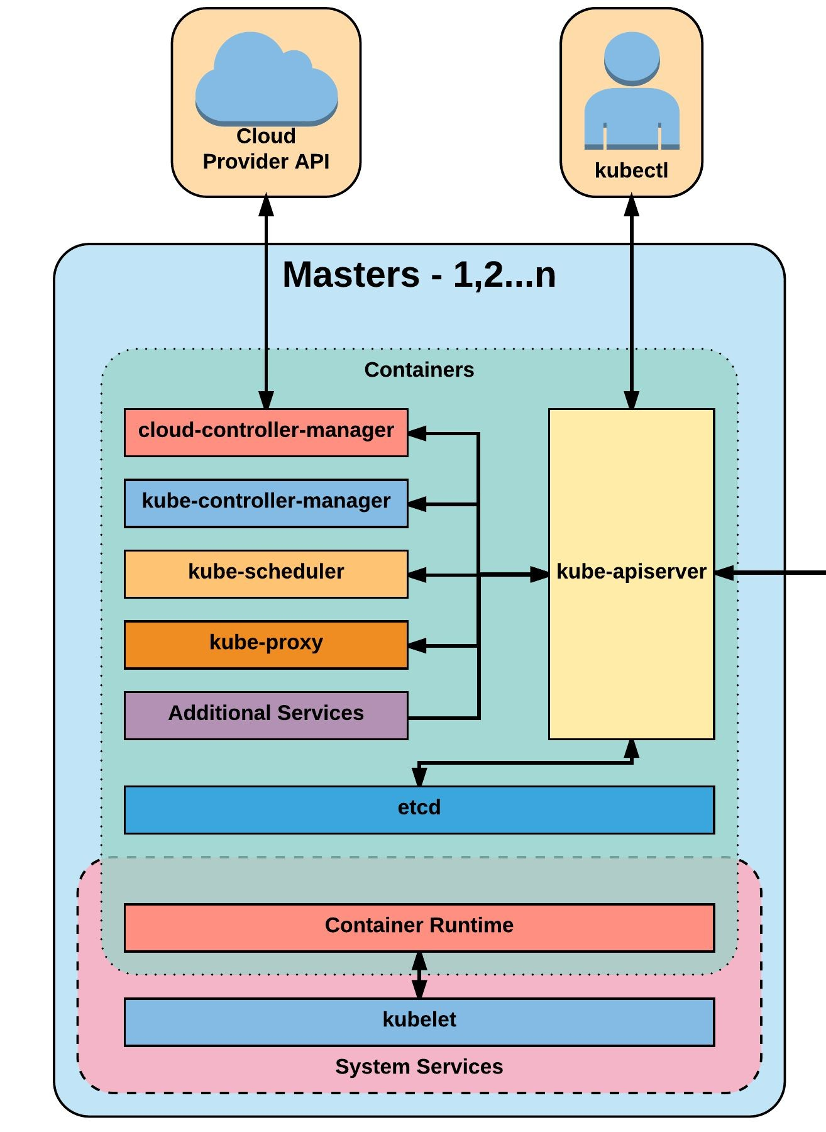
Master Components
Kube-apiserver
Etcd
Kube-controller-manager
Cloud-controller-manager
Kube-scheduler

Slide 7
kube-apiserver
The apiserver provides a forward facing REST interface into the kubernetes control plane and datastore. All clients, including nodes, users and other applications interact with kubernetes strictly through the API Server.
It is the true core of Kubernetes acting as the gatekeeper to the cluster by handling authentication and authorization, request validation, mutation, and admission control in addition to being the front-end to the backing datastore.

Slide 8
etcd
Etcd acts as the cluster datastore; providing a strong, consistent and highly available key-value store used for persisting cluster state.

Slide 9
kube-controller-manager
The controller-manager is the primary daemon that manages all core component control loops. It monitors the cluster state via the apiserver and steers the cluster towards the desired state.
List of core controllers:
https://github.com/kubernetes/kubernetes/blob/master/cmd/kube-controller-manager/app/controllermanager.go#L332

Slide 10
cloud-controller-manager
The cloud-controller-manager is a daemon that provides cloud-provider specific knowledge and integration capability into the core control loop of Kubernetes. The controllers include Node, Route, Service, and add an additional controller to handle PersistentVolumeLabels .

Slide 11
kube-scheduler
Kube-scheduler is a verbose policy-rich engine that evaluates workload requirements and attempts to place it on a matching resource. These requirements can include such things as general hardware reqs, affinity, anti-affinity, and other custom resource requirements.

Slide 12
Node Components

Slide 13
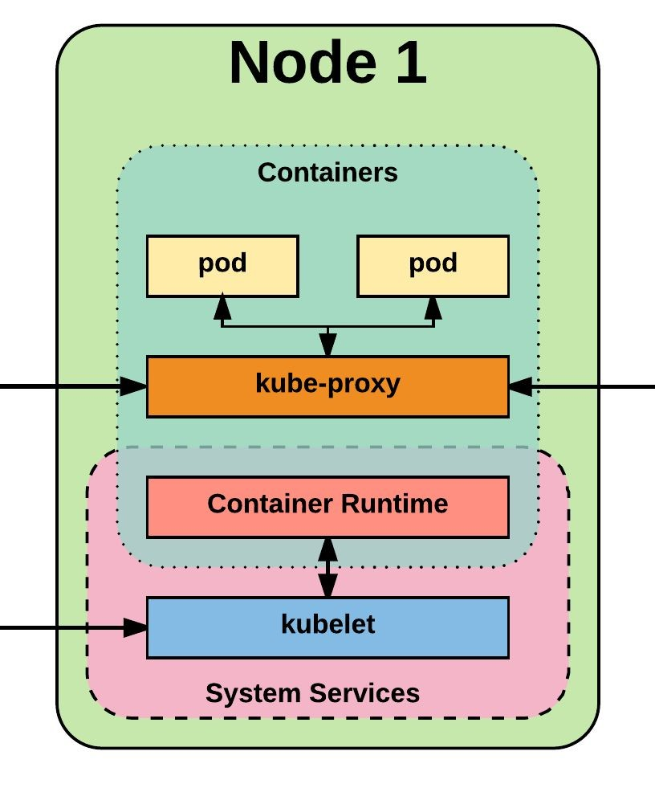
Node Components
Kubelet
Kube-proxy
Container runtime engine

Slide 14
kubelet
Acts as the node agent responsible for managing pod lifecycle on its host. Kubelet understands YAML container manifests that it can read from several sources:
File path
HTTP Endpoint
Etcd watch acting on any changes
HTTP Server mode accepting container manifests over a simple API.

Slide 15
kube-proxy
Manages the network rules on each node and performs connection forwarding or load balancing for Kubernetes cluster services.
Available Proxy Modes:
Userspace
iptables
ipvs (alpha in 1.8)

Slide 16
Container Runtime
With respect to Kubernetes, A container runtime is a CRI (Container Runtime Interface) compatible application that executes and manages containers.
Containerd (docker)
Cri-o
Rkt
Kata (formerly clear and hyper)
Virtlet (VM CRI compatible runtime)

Slide 17
Additional Services
Kube-dns - Provides cluster wide DNS Services. Services are resolvable to
<service>.<namespace>.svc.cluster.local.
Heapster - Metrics Collector for kubernetes cluster, used by some resources such as the Horizontal Pod Autoscaler. (required for kubedashboard metrics)
Kube-dashboard - A general purpose web based UI for kubernetes.

Slide 18
Networking

Slide 19
Networking - Fundamental Rules
All Pods can communicate with all other Pods without NAT
All nodes can communicate with all Pods (and vice-versa) without NAT.
The IP that a Pod sees itself as is the same IP that others see it as.

Slide 20
Networking - Fundamentals Applied
Containers in a pod exist within the same network namespace and share an IP; allowing for intrapod communication over localhost.
Pods are given a cluster unique IP for the duration of its lifecycle, but the pods themselves are fundamentally ephemeral.
Services are given a persistent cluster unique IP that spans the Pods lifecycle.
External Connectivity is generally handed by an integrated cloud provider or other external entity (load balancer)

Slide 21
Networking - CNI
Networking within Kubernetes is plumbed via the Container Network Interface (CNI), an interface between a container runtime and a network implementation plugin.
Compatible CNI Network Plugins:
Calico
Cillium
Contiv
Contrail
Flannel
GCE
kube-router
Multus
OpenVSwitch
OVN
Romana
Weave

Slide 22
Kubernetes
Concepts

Slide 23
Kubernetes Concepts - Core
Cluster - A collection of hosts that aggregate their available resources including cpu, ram, disk, and their devices into a usable pool.
Master - The master(s) represent a collection of components that make up the control plane of Kubernetes. These components are responsible for all cluster decisions including both scheduling and responding to cluster events.
Node - A single host, physical or virtual capable of running pods. A node is managed by the master(s), and at a minimum runs both kubelet and kube-proxy to be considered part of the cluster.
Namespace - A logical cluster or environment. Primary method of dividing a cluster or scoping access.

Slide 24
Concepts - Core (cont.)
Label - Key-value pairs that are used to identify, describe and group together related sets of objects. Labels have a strict syntax and available character set. *
Annotation - Key-value pairs that contain non-identifying information or metadata. Annotations do not have the the syntax limitations as labels and can contain structured or unstructured data.
Selector - Selectors use labels to filter or select objects. Both equality-based (=, ==, !=) or simple key-value matching selectors are supported.

Slide 25
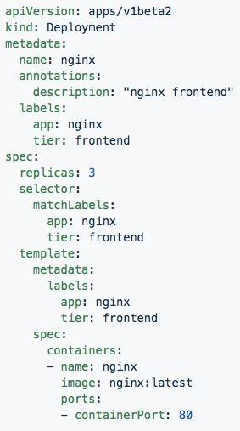
Labels, and Annotations, and Selectors
Labels:
app: nginx
tier: frontned
Annotations
description: “nginx frontend”
Selector: app: nginx
tier: frontend

Slide 26
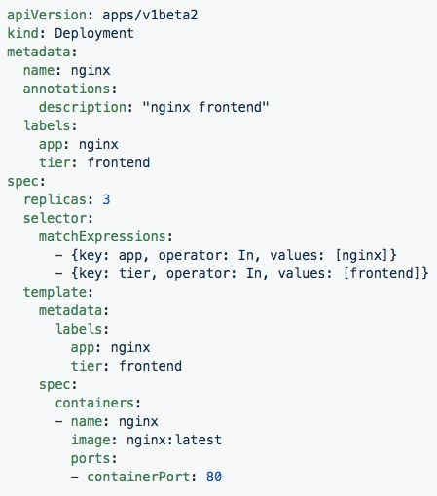
Set-based selectors
Valid Operators:
In
NotIn
Exists
DoesNotExist
Supported Objects with set-based selectors:
Job
Deployment
ReplicaSet
DaemonSet
PersistentVolumeClaims

Slide 27
Concepts - Workloads
Pod - A pod is the smallest unit of work or management resource within Kubernetes. It is comprised of one or more containers that share their storage, network, and context (namespace, cgroups etc).
ReplicationController - Method of managing pod replicas and their lifecycle. Their scheduling, scaling, and deletion.
ReplicaSet - Next Generation ReplicationController. Supports set-based selectors.
Deployment - A declarative method of managing stateless Pods and ReplicaSets. Provides rollback functionality in addition to more granular update control mechanisms.

Slide 28
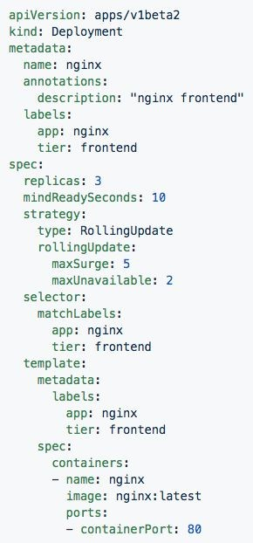
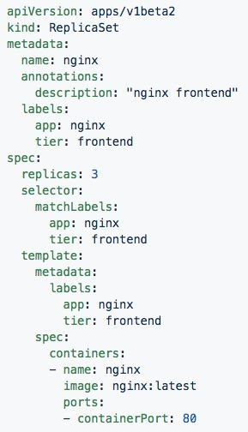
Deployment
ReplicaSet
Generated ReplicaSet from Deployment spec.
Contains configuration of how updates or ‘deployments’ should be managed in addition to the pod template used to generate the ReplicaSet.

Slide 29
Concepts - Workloads (cont.)
StatefulSet - A controller tailored to managing Pods that must persist or maintain state. Pod identity including hostname, network, and storage will be persisted.
DaemonSet - Ensures that all nodes matching certain criteria will run an instance of a supplied Pod. Ideal for cluster wide services such as log forwarding, or health monitoring.

Slide 30
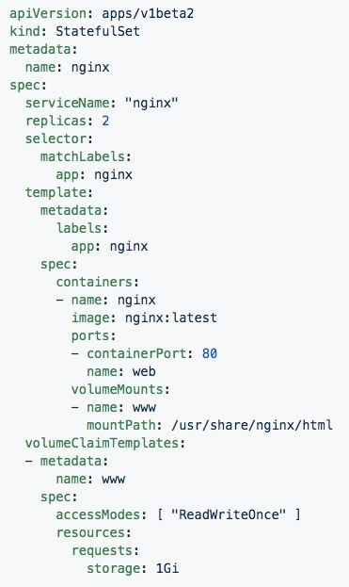
StatefulSet
Attaches to ‘headeless service’ (not shown) nginx.
Pods given unique ordinal names using the pattern
<statefulset name>-<ordinal index>.
Creates independent persistent volumes based on the ‘volumeClaimTemplates’.

Slide 31
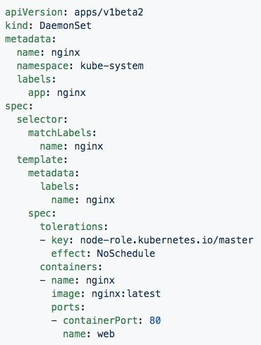
DaemonSet
Bypasses default scheduler
Schedules a single instance on every host while adhering to tolerances and taints.

Slide 32
Concepts - Workloads (cont.)
Job - The job controller ensures one or more pods are executed and successfully terminates. It will do this until it satisfies the completion and/or parallelism condition.
CronJob - An extension of the Job Controller, it provides a method of executing jobs on a cron-like schedule.

Slide 33
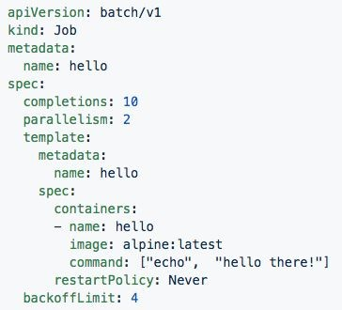
Jobs
Number of pod executions can be controlled via spec.completions
Jobs can be parallelized using spec.parallelism
Jobs and Pods are NOT automatically cleaned up after a job has completed.

Slide 34
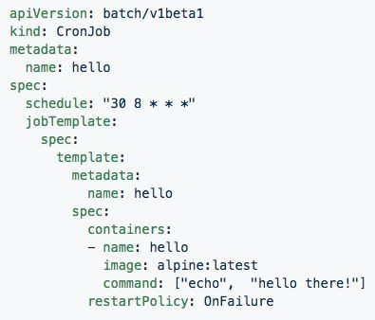
CronJob
Adds cron schedule to job template

Slide 35
Concepts - Network
Service - Services provide a method of exposing and consuming L4 Pod network accessible resources. They use label selectors to map groups of pods and ports to a cluster-unique virtual IP.
Ingress - An ingress controller is the primary method of exposing a cluster service (usually http) to the outside world. These are load balancers or routers that usually offer SSL termination, name-based virtual hosting etc.

Slide 36
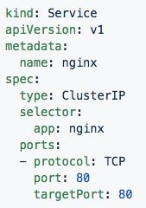
Service
Acts as the unified method of accessing replicated pods.
Four major Service Types:
CluterIP - Exposes service on a strictly cluster-internal IP (default)
NodePort - Service is exposed on each node’s IP on a statically defined port.
LoadBalancer - Works in combination with a cloud provider to expose a service outside the cluster on a static external IP.
ExternalName - used to references endpoints OUTSIDE the cluster by providing a static internally referenced DNS name.

Slide 37
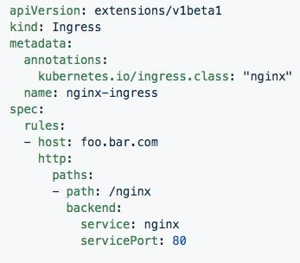
Ingress Controller
Deployed as a pod to one or more hosts
Ingress controllers are an external controller with multiple options.
Nginx
HAproxy
Contour
Traefik
Specific features and controller specific configuration is passed through annotations.

Slide 38
Concepts - Storage
Volume - Storage that is tied to the Pod Lifecycle, consumable by one or more containers within the pod.
PersistentVolume - A PersistentVolume (PV) represents a storage resource. PVs are commonly linked to a backing storage resource, NFS, GCEPersistentDisk, RBD etc. and are provisioned ahead of time. Their lifecycle is handled independently from a pod.
PersistentVolumeClaim - A PersistentVolumeClaim (PVC) is a request for storage that satisfies a set of requirements instead of mapping to a storage resource directly. Commonly used with dynamically provisioned storage.
StorageClass - Storage classes are an abstraction on top of an external storage resource. These will include a provisioner, provisioner configuration parameters as well as a PV reclaimPolicy.

Slide 39
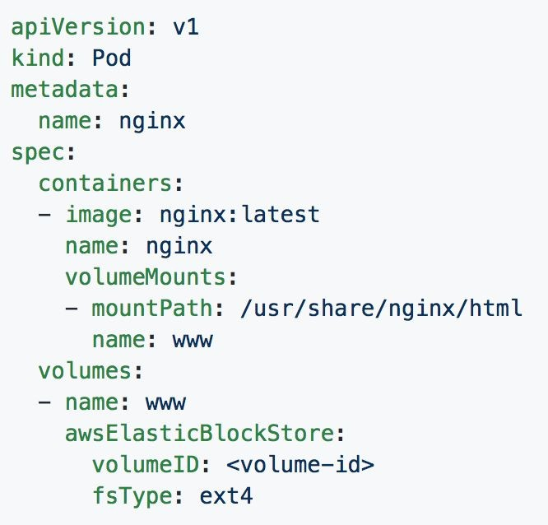
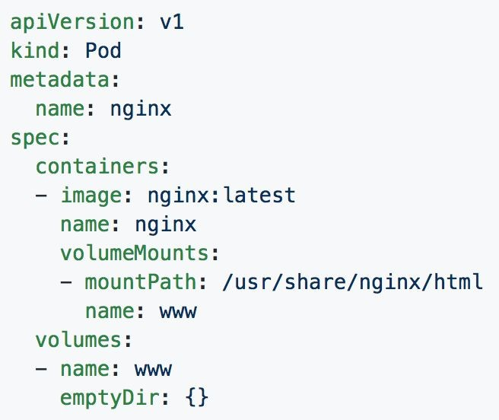
Volumes

Slide 40
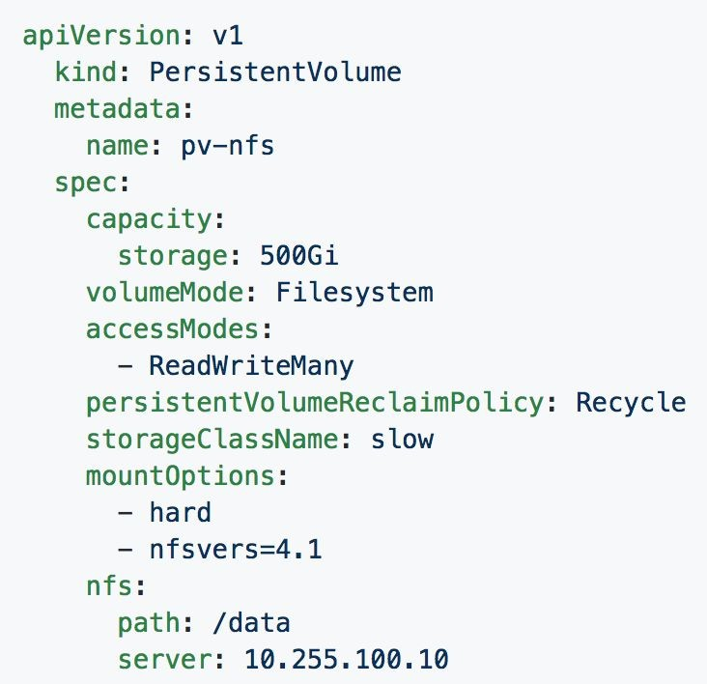
Persistent Volumes
PVs are a cluster-wide resource
Not directly consumable by a Pod
PV Parameters:
Capacity
accessModes
ReadOnlyMany (ROX)
ReadWriteOnce (RWO)
ReadWriteMany (RWX)
persistentVolumeReclaimPolicy
Retain
Recycle
Delete
StorageClass

Slide 41
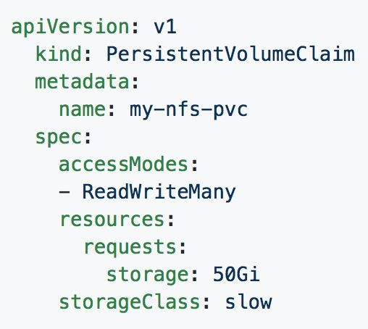
Persistent Volume Claims
PVCs are scoped to namespaces
Supports accessModes like PVs
Uses resource request model similar to Pods
Claims will consume storage from matching PVs or StorageClasses based on storageClass and selectors.

Slide 42
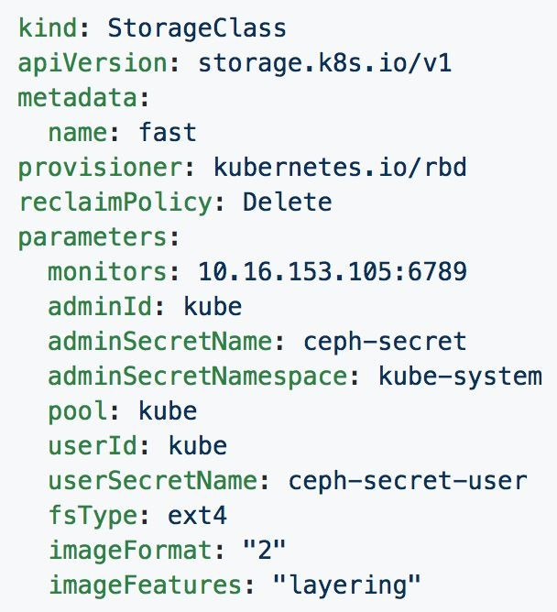
Storage Classes
Uses an external system defined by the provisioner to dynamically consume and allocate storage.
Storage Class Fields
Provisioner
Parameters
reclaimPolicy

Slide 43
Concepts - Configuration
ConfigMap - Externalized data stored within kubernetes that can be referenced as a commandline argument, environment variable, or injected as a file into a volume mount. Ideal for separating containerized application from configuration.
Secret - Functionally identical to ConfigMaps, but stored encoded as base64, and encrypted at rest (if configured).

Slide 44
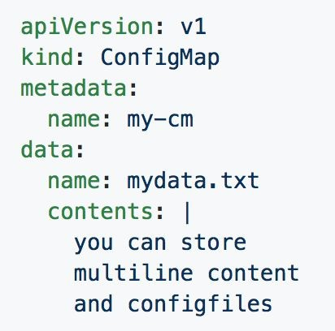
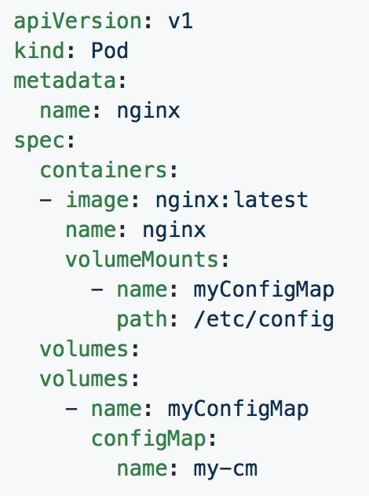
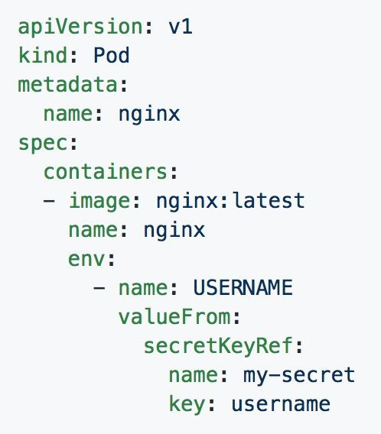
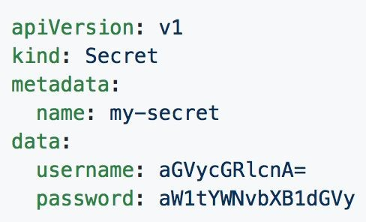
ConfigMaps and Secrets
Can be used in Pod Config:
Injected as a file
Passed as an environment variable
Used as a container command (requires passing as env var)

Slide 45
Concepts - Auth and Identity (RBAC)
[Cluster]Role - Roles contain rules that act as a set of permissions that apply verbs like “get”, “list”, “watch” etc over resources that are scoped to apiGroups. Roles are scoped to namespaces, and ClusterRoles are applied cluster-wide.
[Cluster]RoleBinding - Grant the permissions as defined in a [Cluster]Role to one or more “subjects” which can be a user, group, or service account.
ServiceAccount- ServiceAccounts provide a consumable identity for pods or external services that interact with the cluster directly and are scoped to namespaces.

Slide 46
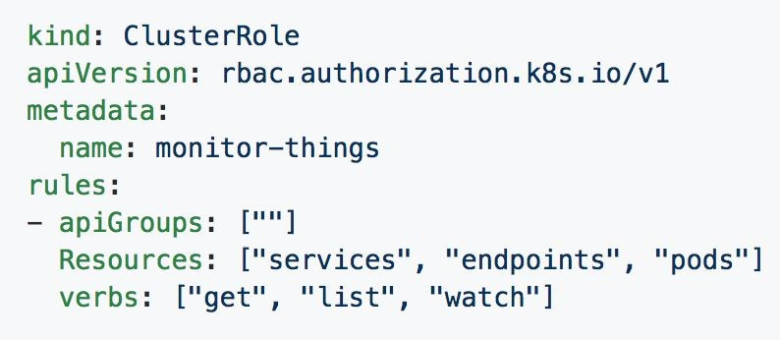
[Cluster]Role
Permissions translate to url path. With “” defaulting to core group.
Resources act as items the role should be granted access to.
Verbs are the actions the role can perform on the referenced resources.

Slide 47
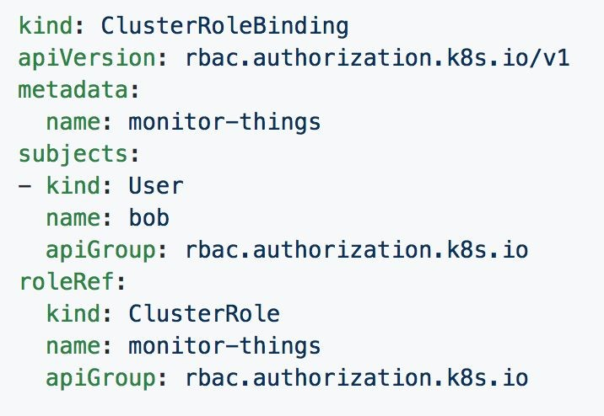
[Cluster]RoleBinding
Can reference multiple subjects
Subjects can be of kind:
User
Group
ServiceAccount
roleRef targets a single role only.

Slide 48
Behind
The Scenes

Slide 49
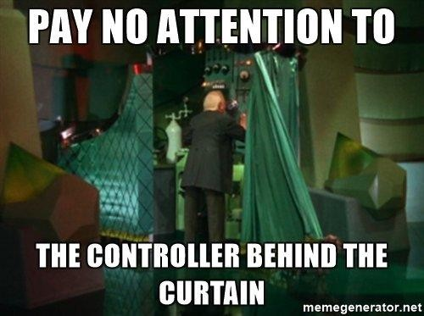
Behind
The Scenes

Slide 50
Deployment From
Beginning to End

Slide 51
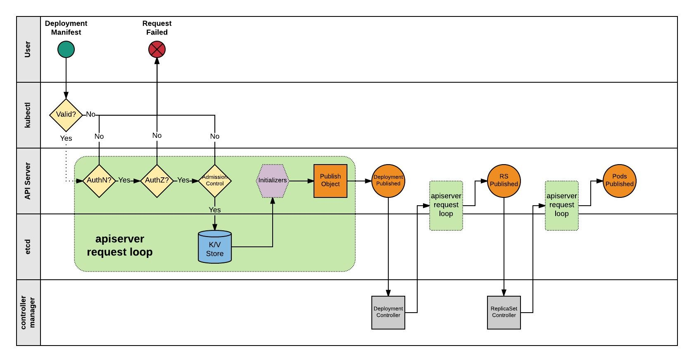

Slide 52
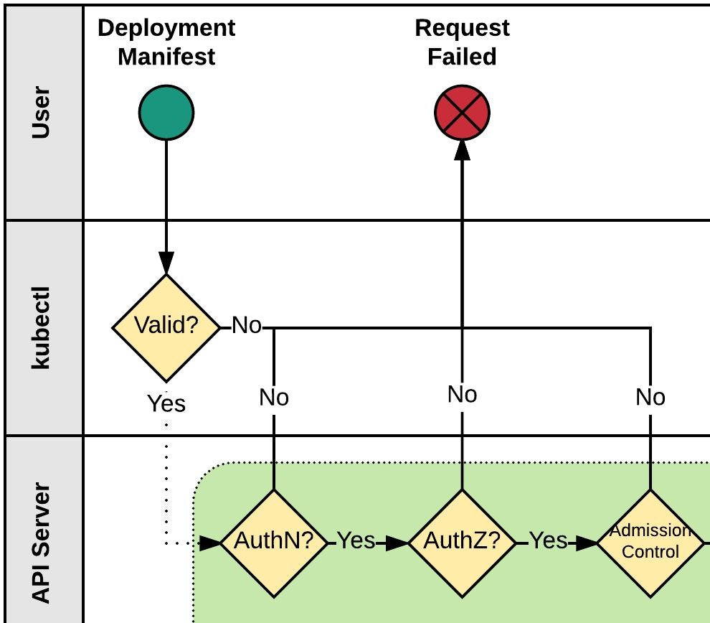
Kubectl
Kubectl performs client side validation on manifest (linting).
Manifest is prepared and serialized creating a JSON payload.

Slide 53
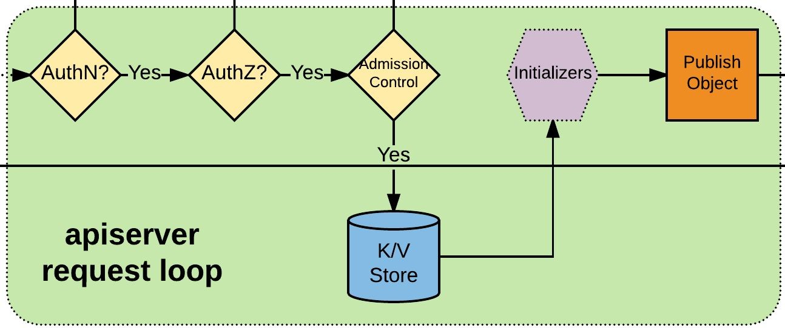
APIserver Request Loop
Kubectl authenticates to apiserver via x509, jwt, http auth proxy, other plugins, or http-basic auth.
Authorization iterates over available AuthZ sources: Node, ABAC, RBAC, or webhook.
AdmissionControl checks resource quotas, other security related checks etc.
Request is stored in etcd.
Initializers are given opportunity to mutate request before the object is published.
Request is published on apiserver.

Slide 54
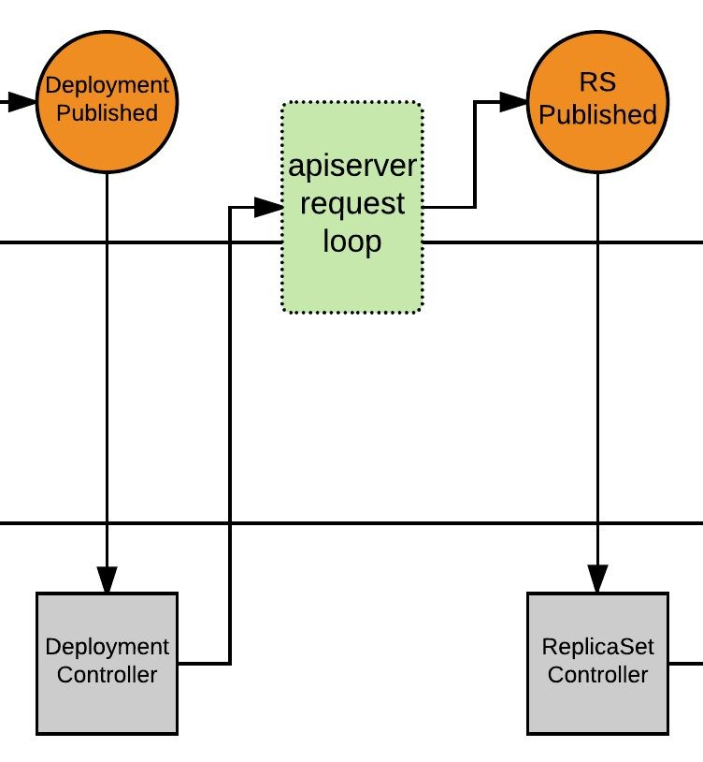
Deployment Controller
Deployment Controller is notified of the new Deployment via callback.
Deployment Controller evaluates cluster state and reconciles the desired vs current state and forms a request for the new ReplicaSet.
apiserver request loop evaluates Deployment Controller request.
ReplicaSet is published.

Slide 55
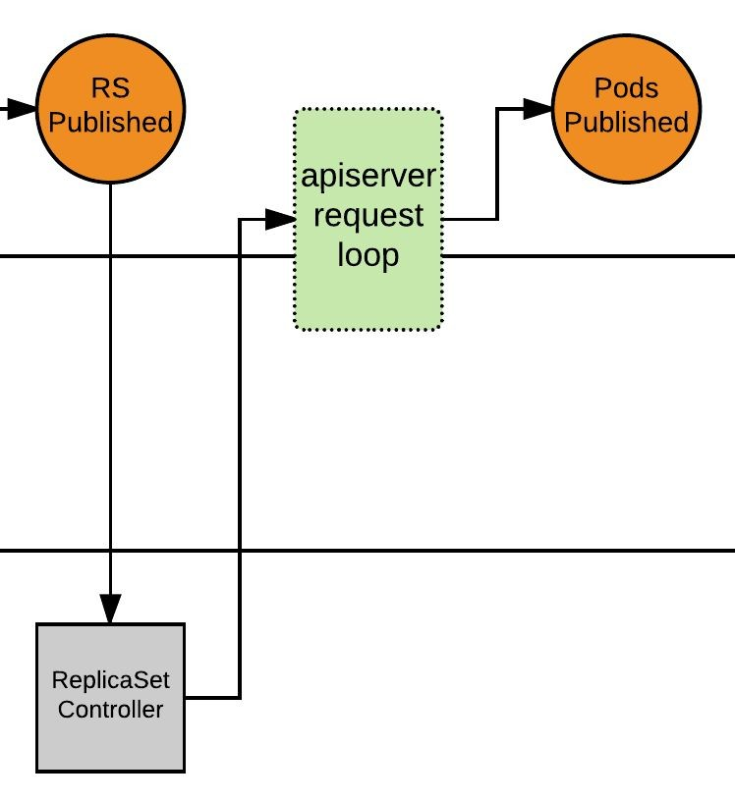
ReplicaSet Controller
ReplicaSet Controller is notified of the new ReplicaSet via callback.
ReplicaSet Controller evaluates cluster state and reconciles the desired vs current state and forms a request for the desired amount of pods.
apiserver request loop evaluates ReplicaSet Controller request.
Pods published, and enter ‘Pending’ phase.

Slide 56
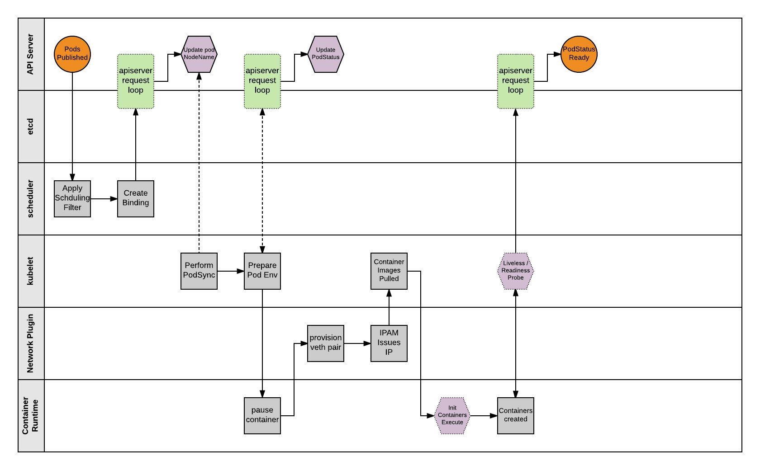

Slide 57
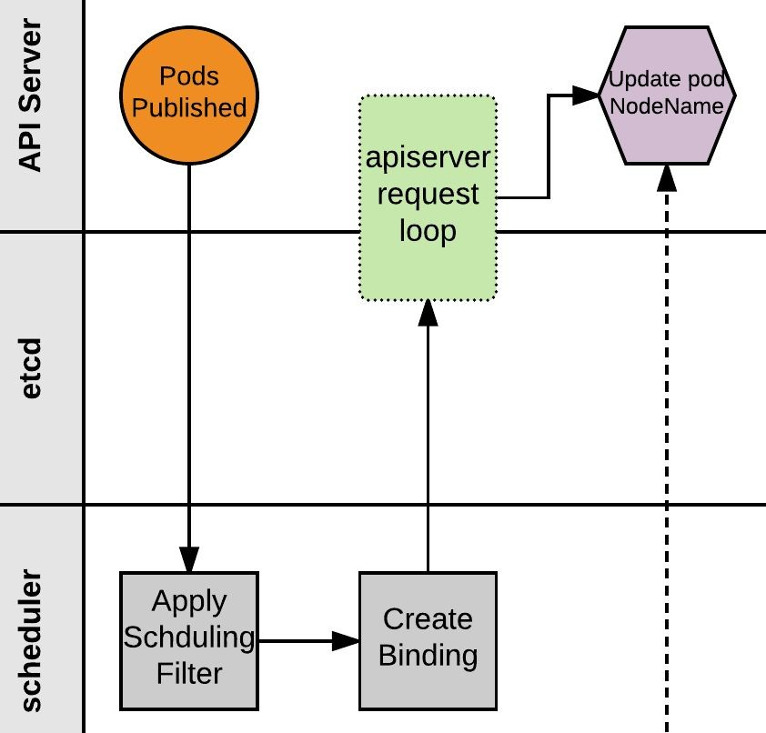
Scheduler
Scheduler monitors published pods with no ‘NodeName’ assigned.
Applies scheduling rules and filters to find a suitable node to host the Pod.
Scheduler creates a binding of Pod to Node and POSTs to apiserver.
apiserver request loop evaluates POST request.
Pod status is updated with node binding and sets status to ‘PodScheduled’.

Slide 58
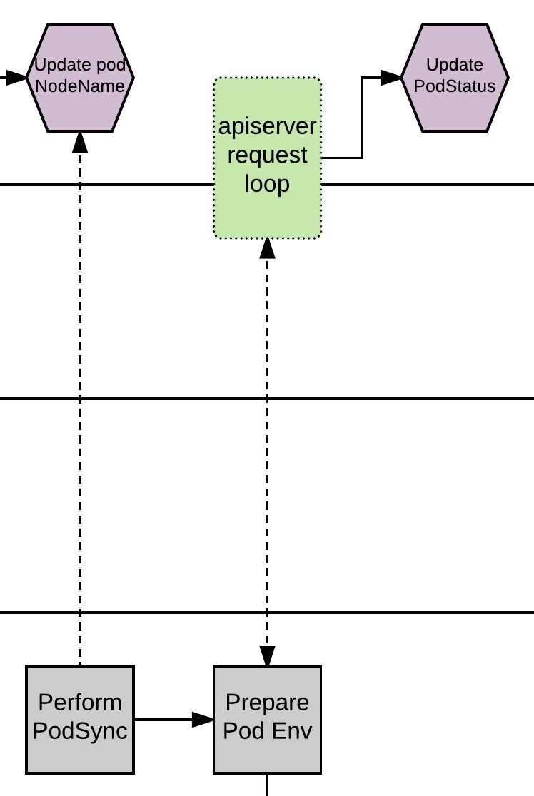
Kubelet - PodSync
The kubelet daemon on every node polls the apiserver filtering for pods matching its own ‘NodeName’; checking its current state with the desired state published through the apiserver.
Kubelet will then move through a series of internal processes to prepare the pod environment. This includes pulling secrets, provisioning storage, applying AppArmor profiles and other various scaffolding. During this period, it will asynchronously be POST’ing the ‘PodStatus’ to the apiserver through the standard apiserver request loop.

Slide 59
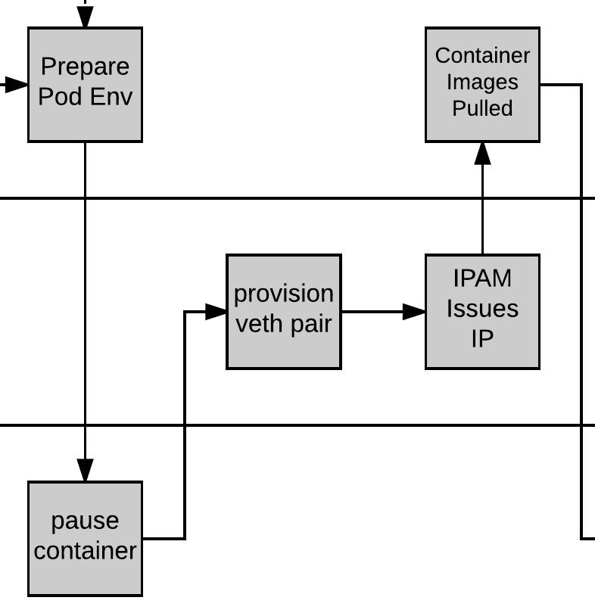
Pause and Plumbing
Kubelet then provisions a ‘pause’ container via the CRI (Container Runtime Interface). The pause container acts as the parent container for the Pod.
The network is plumbed to the Pod via the CNI (Container Network Interface), creating a veth pair attached to the pause container and to a container bridge (cbr0).
IPAM handled by the CNI plugin assigns an IP to the pause container.

Slide 60
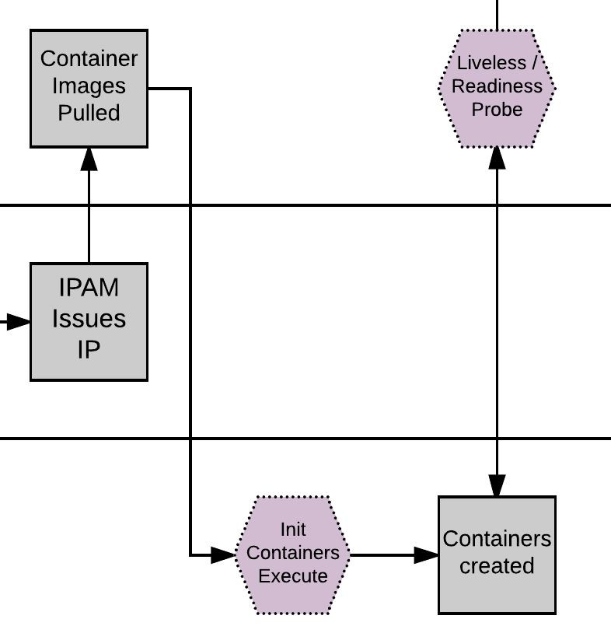
Kublet - Create Containers
Kubelet pulls the container Images.
Kubelet first creates and starts any init containers.
Once the optional init containers complete, the primary pod containers are started.

Slide 61
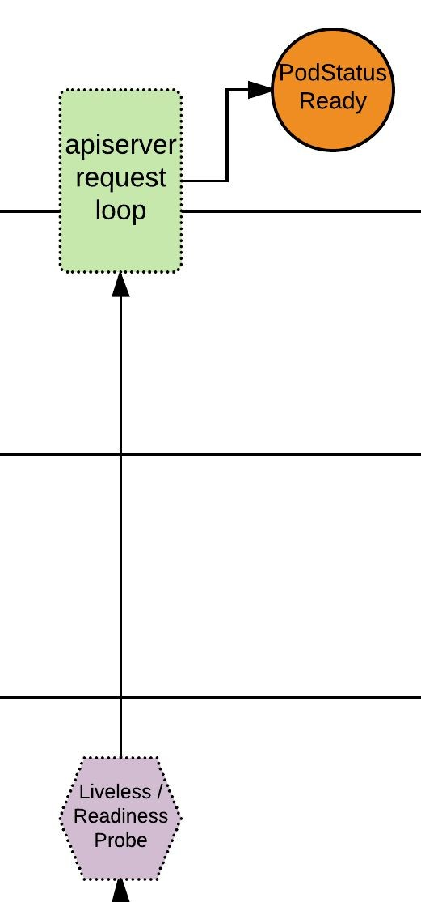
Pod Status
If there are any liveless/readiness probes, these are executed before the PodStatus is updated.
If all complete successfully, PodStatus is set to ready and the container has started successfully.
The Pod is Deployed!

Slide 62
Azure Container Service
Orchestration
&
Microservices

Slide 63
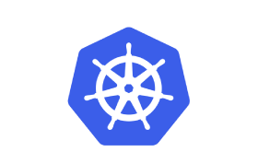
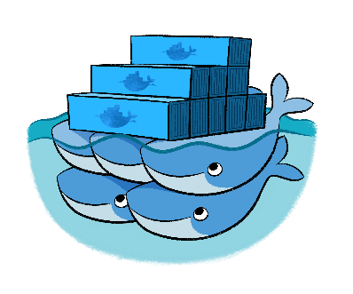

Azure Container Service
Provisioning of DC/OS, Docker, and Kubernetes
Standard Docker tooling and API support
Linux and Windows Server containers
Billed for the compute resource used
Kubernetes
DC/OS
Swarm
Linux: GA Windows: Preview

Slide 64
Azure Container Service
Containers
Orchestrator (Docker Swarm, DC/OS, Kubernetes)
Container Tooling e.g. Docker CLI
Linux
Windows Server
VMs and VM Scale Sets
Service Tooling e.g. ARM Template
Azure Stack
Azure

Slide 65
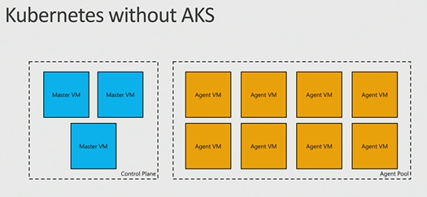
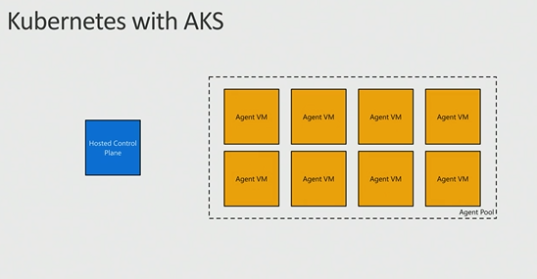
AKS: Managed Kubernetes
Azure-hosted control plane
No master nodes to manage or pay for
Automated upgrades and patching
Easily upgrade control plane and worker nodes to new versions of Kubernetes
Scale agent pool to increase or decrease capacity
Linux: Preview Windows: Not yet
Notes:
Automatic binpacking
Self-healing
Horizontal scaling
Service discovery and load balancing
Automated rollouts and rollbacks
Secret and configuration management
Storage orchestration
Batch execution

Slide 66
Service Fabric
Orchestration, microservices, programming models

Slide 67
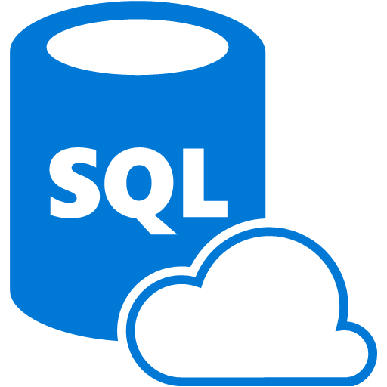



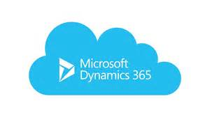



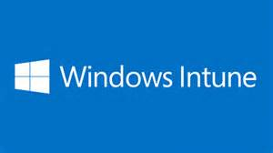
Services Powered by Service Fabric
SQL Database
2.1 million DBs
Cosmos DB
Billions transactions/day
IoT Hub
Millions of messages
Event Hubs
60bn events/day
Skype
Cortana
Intune
Dynamics
Power BI
Windows: GA Linux: Preview

Slide 68



Azure Service Fabric
Any OS, Any Cloud
Lifecycle
Management
Always On Availability
Orchestration
Programming Models
Health & Monitoring
Dev & Ops Tooling
Auto
scaling
Dev Box
Azure
On Premise
Other Clouds
Notes:
Deploy to Azure or to on-premises datacenters that run Windows or Linux with zero code changes. Write once, and then deploy anywhere to any Service Fabric cluster.
Develop scalable applications that are composed of microservices by using the Service Fabric programming models, containers, or any code.
Develop highly reliable stateless and stateful microservices. Simplify the design of your application by using stateful microservices.

Slide 69



Service Fabric Programming Models & CI/CD
Visual
Studio
&
VSTS
Jenkins
&
Eclipse
.NET Core/Full .NET/Java
Reliable Actors
Diagnostics & Monitoring
AppInsights
OMS
ELK
Reliable Services
Guest Executables
Containers
Lifecycle
Management
Auto
scaling
Lifecycle
Management
Always On Availability
Orchestration
Programming Models
Health & Monitoring
Dev & Ops Tooling
Auto
scaling
Dev Box
Azure
On Premise
Other Clouds
Notes:
Use the novel Reliable Actors programming model to create cloud objects with self contained code and state.
Deploy and orchestrate containers that include Windows containers and Linux containers. Service Fabric is a data aware, stateful, container orchestrator.
Deploy applications in seconds, at high density with hundreds or thousands of applications or containers per machine.
Deploy different versions of the same application side by side, and upgrade each application independently.
Manage the lifecycle of your applications without any downtime, including breaking and nonbreaking upgrades.
Scale out or scale in the number of nodes in a cluster. As you scale nodes, your applications automatically scale.
Monitor and diagnose the health of your applications and set policies for performing automatic repairs.
Watch the resource balancer orchestrate the redistribution of applications across the cluster. Service Fabric recovers from failures and optimizes the distribution of load based on available resources.

Slide 70
Advantages of Using an API gateway
It decouples clients from services. Services can be versioned or refactored without needing to update all of the clients.
Services can use messaging protocols that are not web friendly, such as AMQP.
The API Gateway can perform other cross-cutting functions such as authentication, logging, SSL termination, and load balancing.

Slide 71
When to use this architecture
Large applications that require a high release velocity.
Complex applications that need to be highly scalable.
Applications with rich domains or many subdomains.
An organization that consists of small development teams.

Slide 72
Benefits
Independent deployments
Independent development
Small, focused teams
Fault isolation
Mixed technology stacks
Granular scaling
Notes:
Independent deployments. You can update a service without redeploying the entire application, and roll back or roll forward an update if something goes wrong. Bug fixes and feature releases are more manageable and less risky.
Independent development. A single development team can build, test, and deploy a service. The result is continuous innovation and a faster release cadence.
Small, focused teams. Teams can focus on one service. The smaller scope of each service makes the code base easier to understand, and it's easier for new team members to ramp up.
Fault isolation. If a service goes down, it won't take out the entire application. However, that doesn't mean you get resiliency for free. You still need to follow resiliency best practices and design patterns.
Mixed technology stacks. Teams can pick the technology that best fits their service.
Granular scaling. Services can be scaled independently. At the same time, the higher density of services per VM means that VM resources are fully utilized. Using placement constraints, a services can be matched to a VM profile (high CPU, high memory, and so on).

Slide 73
Challenges
Complexity
Development and test
Lack of governance
Network congestion and latency
Data integrity
Management
Versioning
Skillset
Notes:
Independent deployments. You can update a service without redeploying the entire application, and roll back or roll forward an update if something goes wrong. Bug fixes and feature releases are more manageable and less risky.
Independent development. A single development team can build, test, and deploy a service. The result is continuous innovation and a faster release cadence.
Small, focused teams. Teams can focus on one service. The smaller scope of each service makes the code base easier to understand, and it's easier for new team members to ramp up.
Fault isolation. If a service goes down, it won't take out the entire application. However, that doesn't mean you get resiliency for free. You still need to follow resiliency best practices and design patterns.
Mixed technology stacks. Teams can pick the technology that best fits their service.
Granular scaling. Services can be scaled independently. At the same time, the higher density of services per VM means that VM resources are fully utilized. Using placement constraints, a services can be matched to a VM profile (high CPU, high memory, and so on).

Slide 74
Best Practices
Model services around the business domain.
Decentralize everything
Data storage should be private to the service that owns the data
Services communicate through well-designed APIs
Avoid coupling between services
Offload cross-cutting concerns, such as authentication and SSL termination, to the gateway.
Keep domain knowledge out of the gateway
Services should have loose coupling and high functional cohesion
Isolate failures
Notes:
Model services around the business domain.
Decentralize everything. Individual teams are responsible for designing and building services. Avoid sharing code or data schemas.
Data storage should be private to the service that owns the data. Use the best storage for each service and data type.
Services communicate through well-designed APIs. Avoid leaking implementation details. APIs should model the domain, not the internal implementation of the service.
Avoid coupling between services. Causes of coupling include shared database schemas and rigid communication protocols.
Offload cross-cutting concerns, such as authentication and SSL termination, to the gateway.
Keep domain knowledge out of the gateway. The gateway should handle and route client requests without any knowledge of the business rules or domain logic. Otherwise, the gateway becomes a dependency and can cause coupling between services.
Services should have loose coupling and high functional cohesion. Functions that are likely to change together should be packaged and deployed together. If they reside in separate services, those services end up being tightly coupled, because a change in one service will require updating the other service. Overly chatty communication between two services may be a symptom of tight coupling and low cohesion.
Isolate failures. Use resiliency strategies to prevent failures within a service from cascading.

